Slide 1
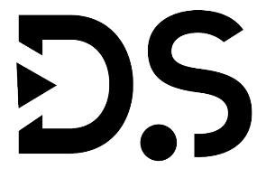
Data
Structures

Slide 2
Time Complexity
Dineshkumar Thangavel

Slide 3
Time Complexity
Asymptotic
Notation
How
To
Analyze
Time
&
Space Complexity
Algorithm
Complexity

Slide 4

How to Analyze
The efficiency of an algorithm must be checked and maintained in two stages:
1
2
Prior
Posterior

Slide 5
Prior
Meaning: "A priori" means "from the earlier" or "before the fact." It refers to knowledge or reasoning that is independent of empirical evidence or prior to experience.
Examples: Mathematical truths like 2 + 2 = 4, or logical principles such as the law of non-contradiction (a statement cannot be both true and false at the same time) are typically considered a priori knowledge. These truths are known without the need for observation or experience.

Slide 6
Posterior
Meaning: "A posteriori" means "from the later" or "after the fact." It refers to knowledge or reasoning that is based on empirical evidence or information acquired through experience.
Examples: Scientific facts, historical events, and personal experiences are examples of a posteriori knowledge. For instance, the knowledge that water boils at 100 degrees Celsius at sea level is a posteriori knowledge because it is based on empirical observations and can vary under different conditions.

Slide 7
Algorithm Complexity
An algorithm is defined as complex based on the amount of Space and Time it consumes. Hence the Complexity of an algorithm refers to the measure of the time that it will need to execute and get the expected output, and the Space it will need to store all the data (input, temporary data, and output). Hence these two factors define the efficiency of an algorithm. The two factors of Algorithm Complexity are:
Time Factor: Time is measured by counting the number of key operations such as comparisons in the sorting algorithm.
Space Factor: Space is measured by counting the maximum memory space required by the algorithm to run/execute.

Slide 8
Asymptotic Notation
Asymptotic notation is a mathematical framework used in computer science and mathematics to describe the behavior of functions as their input values become arbitrarily large (i.e., as they approach infinity).
It is particularly useful for analyzing the time and space complexity of algorithms because it provides a way to describe how resource usage grows as the input size increases without getting into the fine details of constant factors or lower-order terms.
Three commonly used asymptotic notations are Big O notation (O), Omega notation (Ω), and Theta notation (Θ):

Slide 9
Big O Notation
Definition: Big O notation describes an upper bound on the growth rate of a function. In other words, it provides an upper limit on how a function's value grows in relation to the size of its input.
Usage: It is often used to describe the worst-case time or space complexity of an algorithm.
Example: If an algorithm has a time complexity of O(n^2), it means that the execution time grows quadratically with the size of the input.
The function f(n) = O(g(n)), such that f(n) <= c * g(n)

Slide 10
Omega Ω Notation
Definition: Omega notation describes a lower bound on the growth rate of a function. It provides a lower limit on how a function's value grows in relation to the size of its input.
Usage: It is used to describe the best-case time or space complexity of an algorithm.
Example: If an algorithm has a time complexity of Ω(n), it means that the execution time grows linearly with the size of the input.
The function f(n) = O(g(n)), such that f(n) >= c * g(n)

Slide 11
Theta Ɵ Notation
Definition: Theta notation provides average bound (both upper and lower bounds) on the growth rate of a function. It describes how a function's value grows tightly within certain bounds as the input size increases.
Usage: It is used when the best-case and worst-case time or space complexities of an algorithm are the same.
Example: If an algorithm has a time complexity of Θ(n), it means that the execution time grows linearly with the size of the input, and this growth rate is both an upper and lower bound.
The function f(n) = O(g(n)), such that c1 * g(n) <= f(n) <= c2 * g(n)

Slide 12
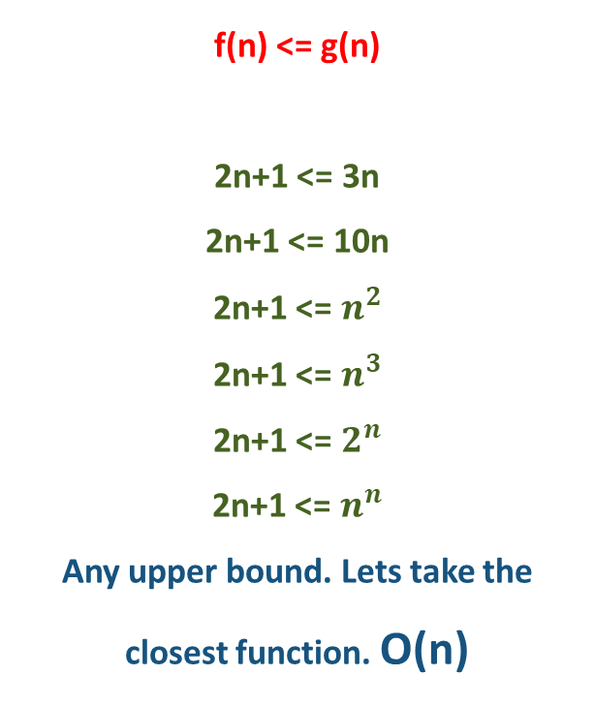
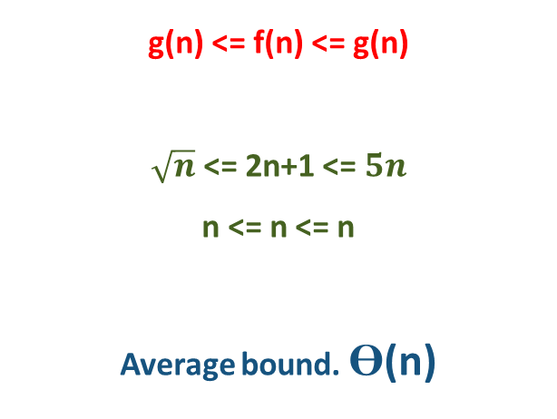
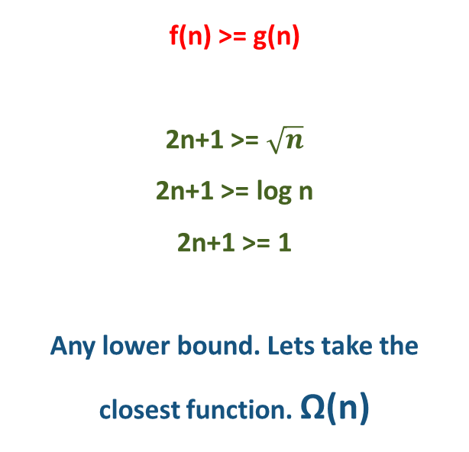
Big Oh
Big Omega
Big Theta
f(n) = O(g(n)), such that f(n) <= c * g(n)
f(n) = O(g(n)), such that f(n) >= c * g(n)
f(n) = O(g(n)), such that
c1 * g(n) <= f(n) <= c2 * g(n)
f(n) <= g(n)
2n+1 <= 3n
2n+1 <= 10n
2n+1 <= $n^{2}$
2n+1 <= $n^{3}$
2n+1 <= $2^{n}$
2n+1 <= $n^{n}$
Any upper bound. Lets take the closest function. O(n)
f(n) >= g(n)
2n+1 >= $\sqrt{n}$
2n+1 >= log n
2n+1 >= 1
Any lower bound. Lets take the closest function. Ω(n)
g(n) <= f(n) <= g(n)
$\sqrt{n}$ <= 2n+1 <= $5n$
n <= n <= n
Average bound. Ɵ(n)

Slide 13
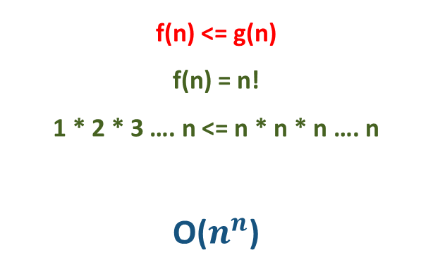
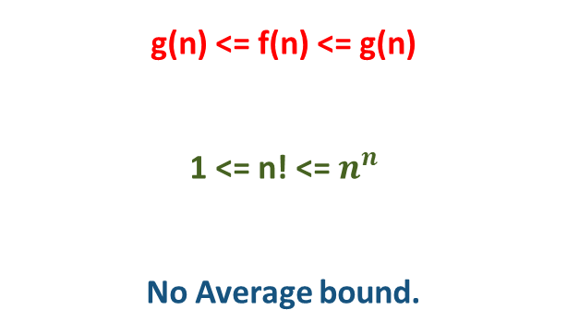
Big Oh
Big Omega
Big Theta
f(n) = O(g(n)), such that f(n) <= c * g(n)
f(n) = O(g(n)), such that f(n) >= c * g(n)
f(n) = O(g(n)), such that
c1 * g(n) <= f(n) <= c2 * g(n)
f(n) <= g(n)
f(n) = n!
1 * 2 * 3 …. n <= n * n * n …. n
O($n^{n}$)
f(n) >= g(n)
f(n) = n!
1 * 2 * 3 …. n >= 1 * 1 * 1 …. 1
Ω(1)
g(n) <= f(n) <= g(n)
1 <= n! <= $n^{n}$
No Average bound.

Slide 14
Best, Worst & Average Case
In computer science, algorithms are often analyzed in terms of their time complexity, which describes how the running time of an algorithm grows as the size of the input data increases. There are three main categories for time complexity analysis: best case, worst case, and average case.
Best Case Time Complexity:
The best case time complexity represents the minimum amount of time an algorithm takes to complete when given the input for which it performs most efficiently.
It's denoted by O(f(n)), where f(n) is some function of the input size 'n'.
The best case scenario is often a theoretical lower bound and might not always reflect real-world performance.
Best case analysis is useful for understanding the lower limit of an algorithm's performance.

Slide 15
Best, Worst & Average Case
Worst Case Time Complexity:
The worst case time complexity represents the maximum amount of time an algorithm takes to complete when given the input for which it performs least efficiently.
It's also denoted by O(f(n)), where f(n) is a function of the input size 'n'.
The worst case scenario is essential in critical applications where you need to ensure that the algorithm will not take too long, even in the worst possible situation.
In practice, many algorithms are designed with a focus on their worst-case performance.

Slide 16
Best, Worst & Average Case
Average Case Time Complexity:
The average case time complexity represents the expected or average amount of time an algorithm takes to complete when given a random input from a specified distribution.
It's denoted by O(f(n)), where f(n) is a function of the input size 'n'.
Average case analysis is often more realistic than best or worst case analysis because it considers the typical inputs an algorithm is likely to encounter.
Calculating the average case complexity requires knowledge of the input distribution and probabilistic analysis.

Slide 17
2 | 5 | 14 | 26 | 34 | 36 | 42 | 47 | 49 | 59
Linear Search
Binary Search
Best Case:
Search Key = 2
Time Complexity: O(1)
Worst Case:
Search Key = 59
Time Complexity: O(n)
Average Case:
Search Key = 34
Time Complexity: O(n)
Best Case:
Search Key = 2
Time Complexity: O(1)
Worst Case:
Search Key = 59
Time Complexity: O(log n)
Average Case:
Search Key = 34
Time Complexity: O(log n)

Slide 18
Thank You

